Slide 1


Crime (Fight & Object) Detection System
AI & Data Science Graduation Project

Slide 2
Our Team:
Eng. Mohamed Osama Faid
Eng. Mohamed Mostafa El-Sayed
Eng. Ahmed Ezzat Moustafa
Eng. Karim Mohamed Hafez
Eng. Mahmoud Yossry Elmetwallli
Eng. Rana Hassan Badrawi
Supervisors:
Eng. Mariam Elsaee & Dr. Nesma Ibrahim

Slide 3
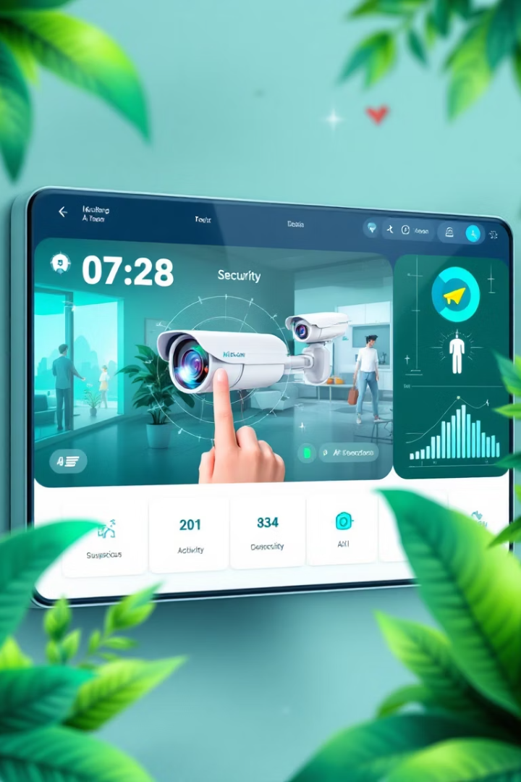



Project introduction
Security Enhancement
Dual-Stream System
An intelligent video analysis system that detects and recognizes criminal activities in surveillance footage using AI-powered technologies.
Custom 3D CNN for action recognition and YOLOv8 for weapon detection & fire hazard.
Also a User-Friendly Interface
Gradio-based web application hosted on HuggingFace Spaces for individuals and developing purposes.

Slide 4




Problem Statement – What's Wrong?
Manual and reactive methods: Law enforcement relied on routine patrols, manual crime analysis, and post-crime investigations, which delayed responses and allowed crime rates to remain high.
Limited predictive capabilities: There was no reliable system to predict where or when crimes might occur.
Slow response times: Emergency services relied on limited caller information, leading to delays.
In Los Angeles, the "Operation LASER" a similar system AI-based helped reduce violent crimes by 25% in targeted zones through crime pattern analysis, AI tools analyze hours of surveillance footage in minutes, improving evidence collection.
Also real-time emergency response were 40% faster.
though, integrating a similar smart system well trained & suitable for our society is urgent need.

Slide 5
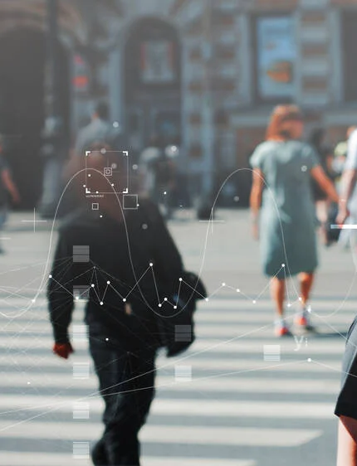
🔍 Why our Project Matters?
📈 Adapting to Growing Populations As population density increases, traditional security methods alone are no longer enough.
🤖 Empowering the AI Era Integrating AI with surveillance systems boosts the efficiency of security operations.
🚨 Faster Emergency Response Smart detection enables real-time alerts and quicker reactions to threats.
👁️‍🗨️ Reduced Human Monitoring Load Automates threat detection, allowing security personnel to focus on critical tasks.
🎥 Better Evidence Collection Advanced video analysis ensures accurate documentation of incidents.

Slide 6
Literature Review / Related Work
In our project we reviewed some related works, after giving thanks to them we were able to focus some points, adding good progress of ComV at this field:
Project Name | Year | Pros | Cons
Detection (Vision-based Fight Akti et al.) | 2020 | • LSTM + attention. • 2D CNNs. • New dataset introduced. | • No weapon detection.
JOSENet (Nardelli et al.) | 2024 | • RGB + Optical Flow. • Low memory cost. | • Precomputed optical flow needed. • Not real-time.
VIVIT (Singh et al.) | 2022 | • State-of-the-art accuracy. • Captures long-range features. | • Slow processing. • Requires large datasets.
Real-Time Weapon Detection (YOLOv5) (Senjab) | 2020 | • Simple PyQt5 interface. • Real-time inference. | • No action recognition. • Ignores behavioral context.
Weapon Detection in Videos (YOLOv5) (Sabari S.) | 2021 | • Frame-based violence scoring. • Visual weapon detection. | • No behavioral analysis. • Misclassification risks.
Violence Detection in Surveillance Videos (Moaaz) | 2020 | • High accuracy on standard datasets. • Uses temporal features. | • Unspecified architecture. • Not designed for real-time.
Dual Detection System: Combines fight detection (3D CNN) and weapon detection (YOLOv8) in one pipeline.
Modular & Scalable: Clean architecture with plans for real-time CCTV integration coming in Phase 2.
Web Interface: Django-based upload system for user-friendly access.
Custom Frame Processing: Tailored OpenCV function handles diverse video types efficiently.
Supports Multi-User Roles: Designed for both general users and security staff.

Slide 7
Technical details.
System Architecture
Testing & Quality
KPIs
Flow Diagrams
Techs Used
Project Timeline

Slide 8
Technologies Used
• YOLOv8 - Objects Detection.
• TensorFlow-keras - 3D CNN for Action Recognition.
• Gradio - Web UI.
• OpenCV, MoviePy - Video Processing.
Robflow for collecting data & wandb for analysis & Kaggle for training.

Slide 9
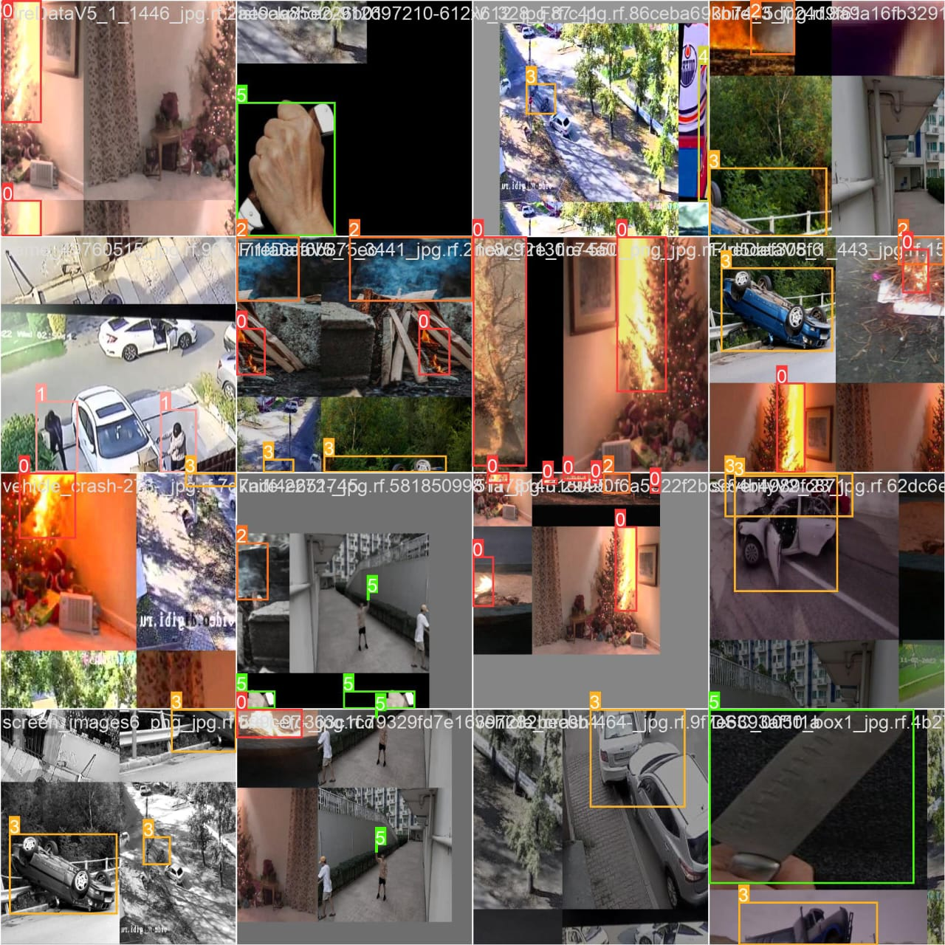
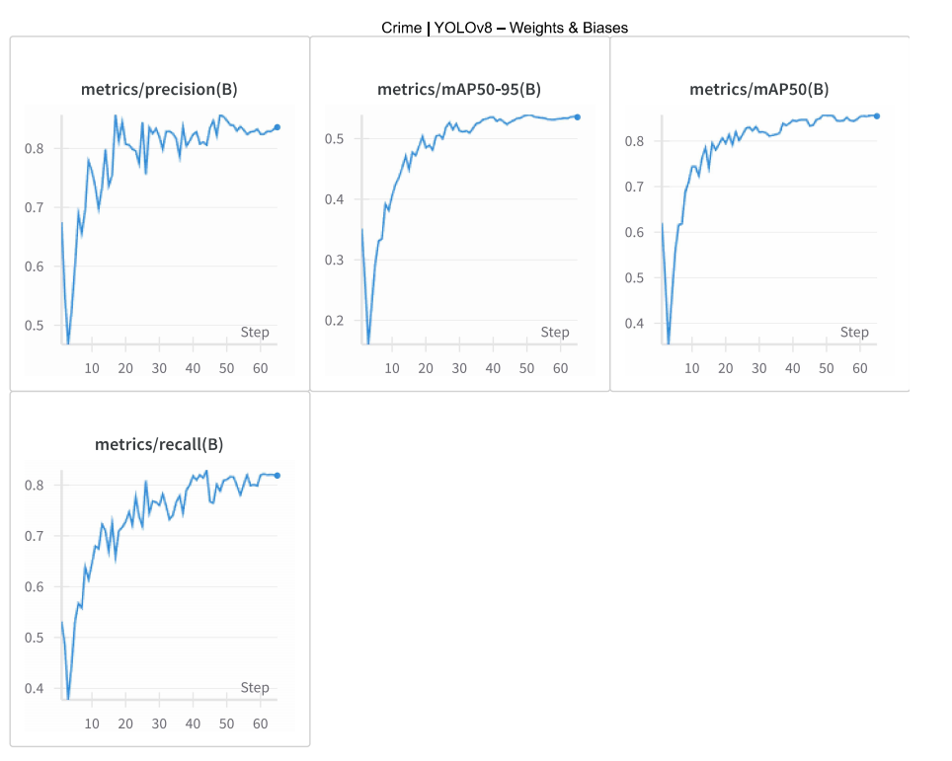
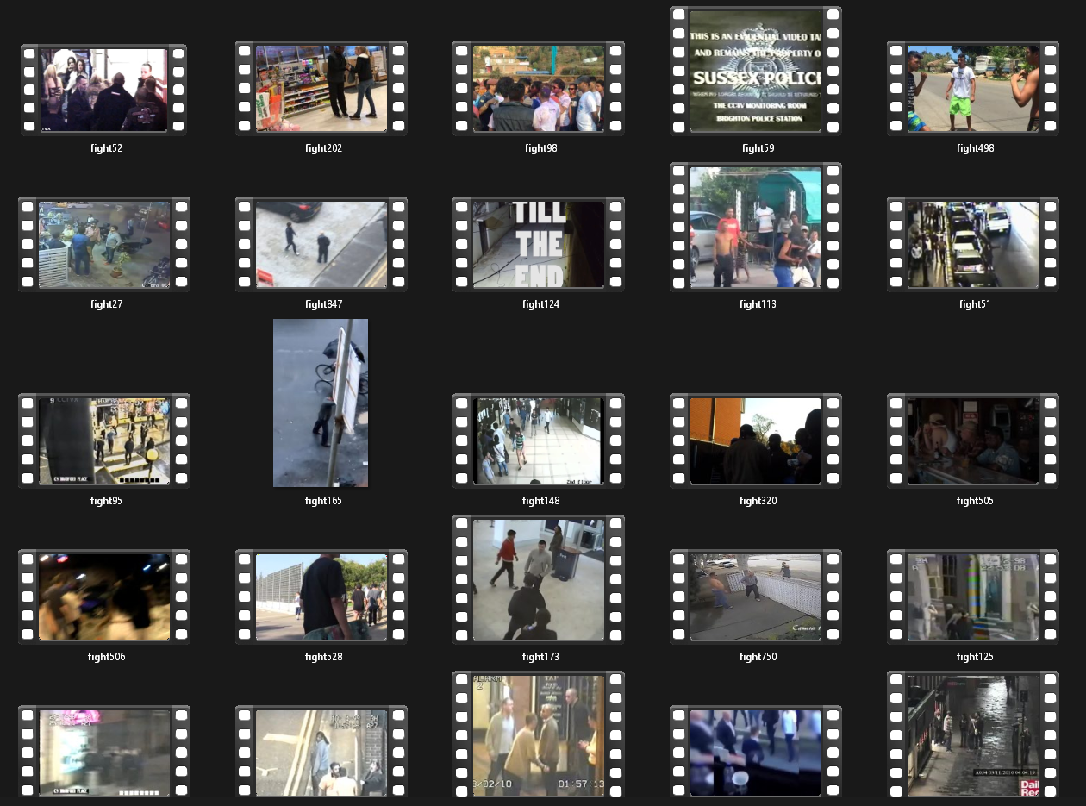
Collection data
Roboflow for collecting yolo images data
wandb for analysis and chats
Kaggle for action videos & training

Slide 10





System Architecture
Input Layer
Video upload interface accepting for non-tech users & technical version for custom developing.
Preprocessing Layer
Frame slicing and resizing for model compatibility.
Detection Layers
YOLOv8 for weapons & fire, 3D CNN tensorflow-keras for violent actions.
Overlay Engine
Annotation on frames with detection results.(results only for non-tech users)
Postprocessing
Video compilation and delivery to user.

Slide 11
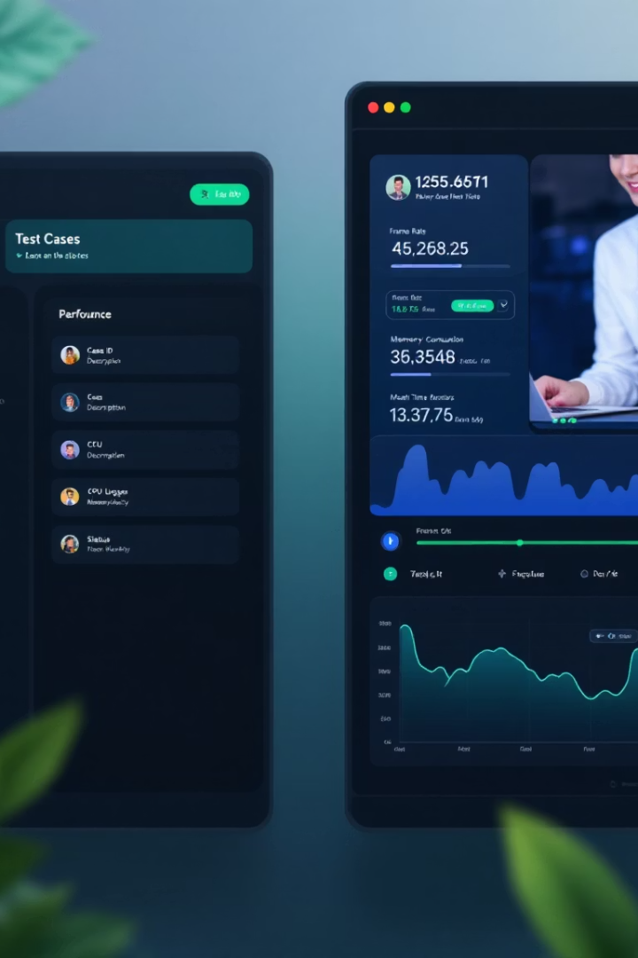
Testing & Quality Assurance
Module
Test Case
Expected Result
Video Upload
Accept .mp4, .avi, .mpeg
Success
Frame Extraction
Correct FPS extraction
Verified
Action Model
Classify 30-frame clips
≥91% accuracy
YOLO Detection
Identify Objects
≥80% precision
Integration
Combined model output
Functional

Slide 12

Key Performance Indicators
Fight detection Model Training Performance
Metric | Value | Epoch
Best Training Accuracy | 0.8583 | 7
Best Validation Accuracy | 0.9167 | 10
Lowest Training Loss | 0.3636 | 7
Lowest Validation Loss | 0.2805 | 8

Slide 13
Key Performance Indicators
🔍 YOLOv8 Detection Performance Metrics
Metric | Value | Interpretation (What it means)
mAP@0.5 | 0.80 | Excellent object detection at IoU ≥ 0.5. Model locates objects accurately even with slight shape/size variations.
mAP@0.5:0.95 | 0.50 | Moderate performance. Indicates room for improvement in detecting small or complex objects.
Precision | 0.80 | High precision. 80% of detected objects are true positives, with few false alarms.
Recall | 0.70 | Medium recall. Model captures 70% of actual objects, missing 30% (false negatives).

Slide 14
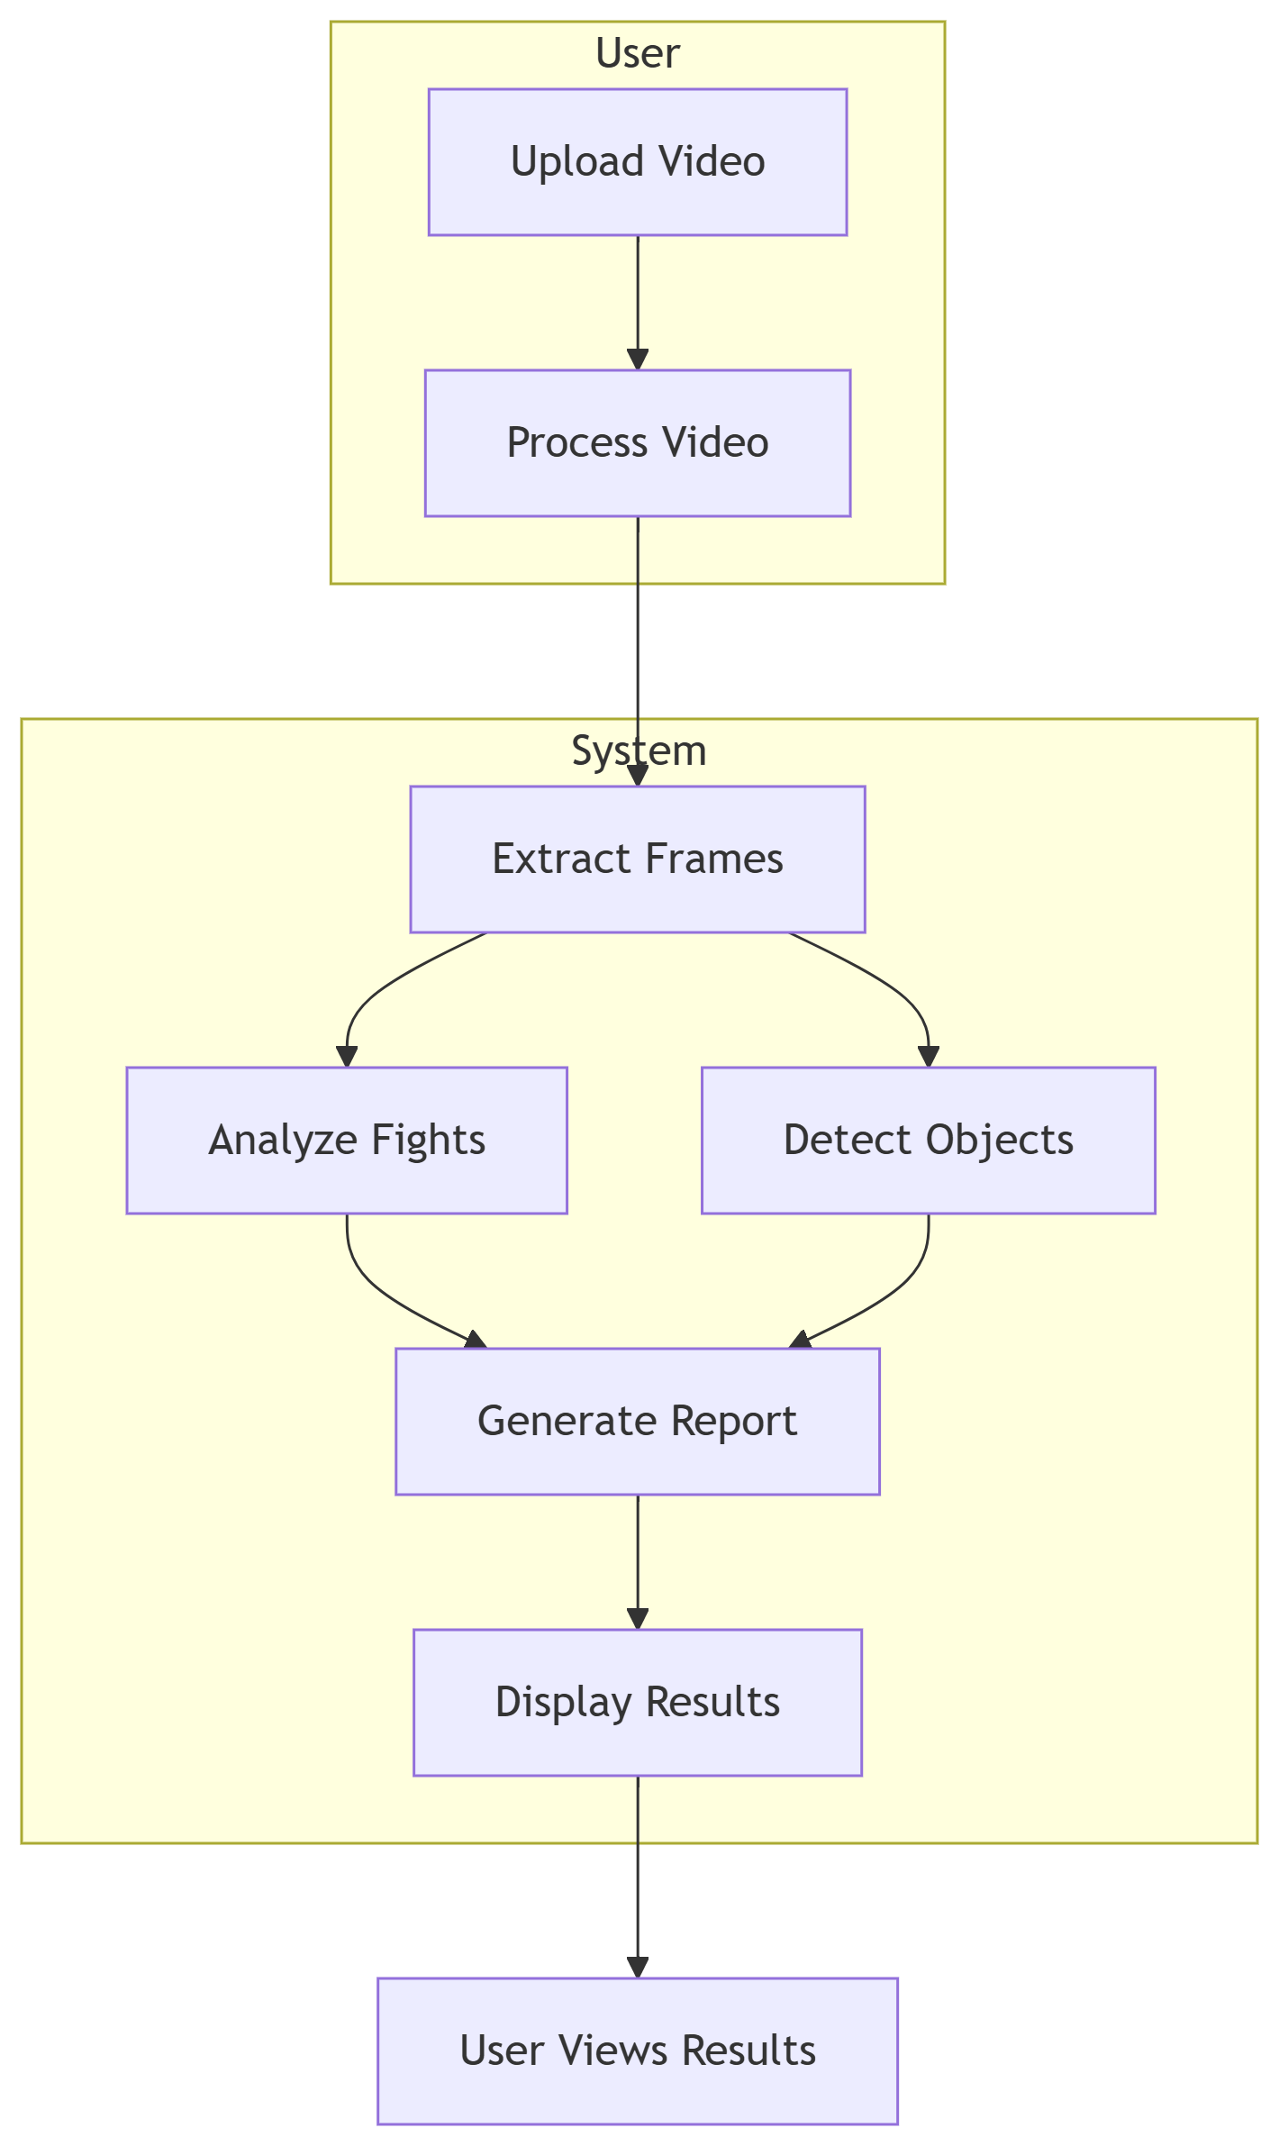
Data Flow Diagram

Slide 15
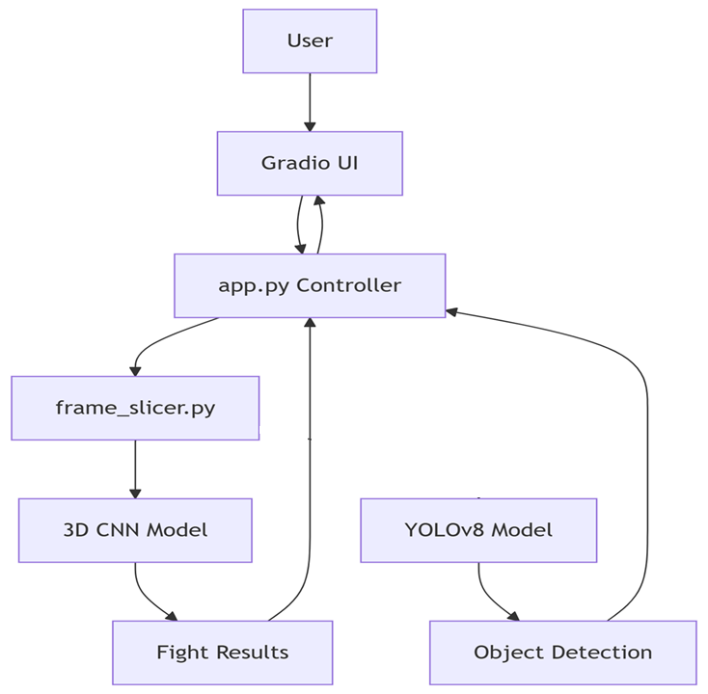
Software Architecture Diagram

Slide 16
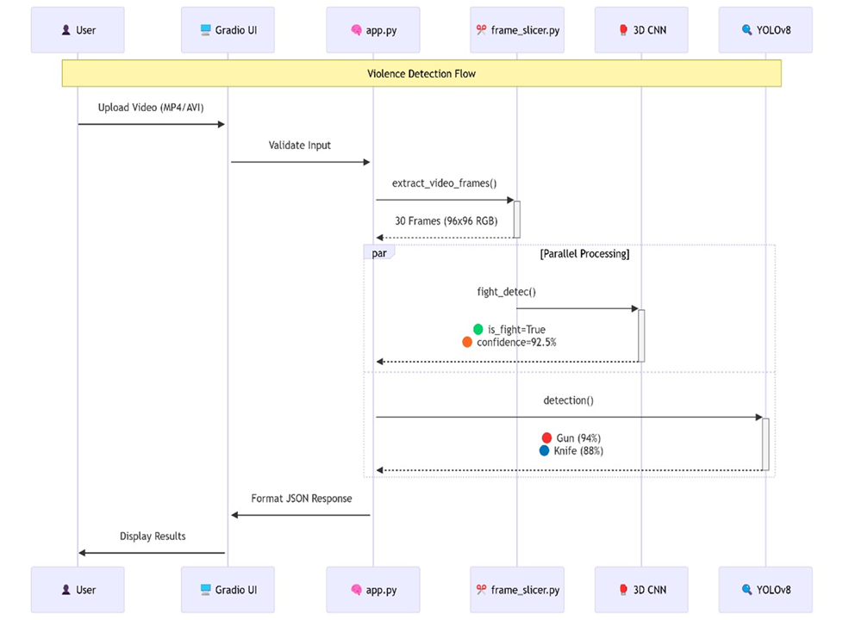
Use Case

Slide 17
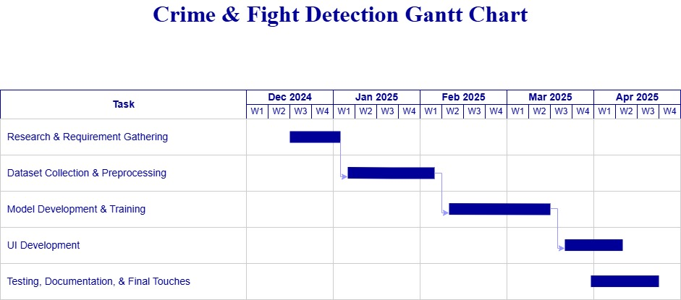




Project Timeline
Planning Phase
Testing
Project proposal, requirements gathering, and Data Preprocessing.
Quality assurance, bug fixes, and performance optimization.
Development
Deployment
Model training, integration, and system architecture implementation.
Hugging Face Spaces
deployment with documentation.

Slide 18
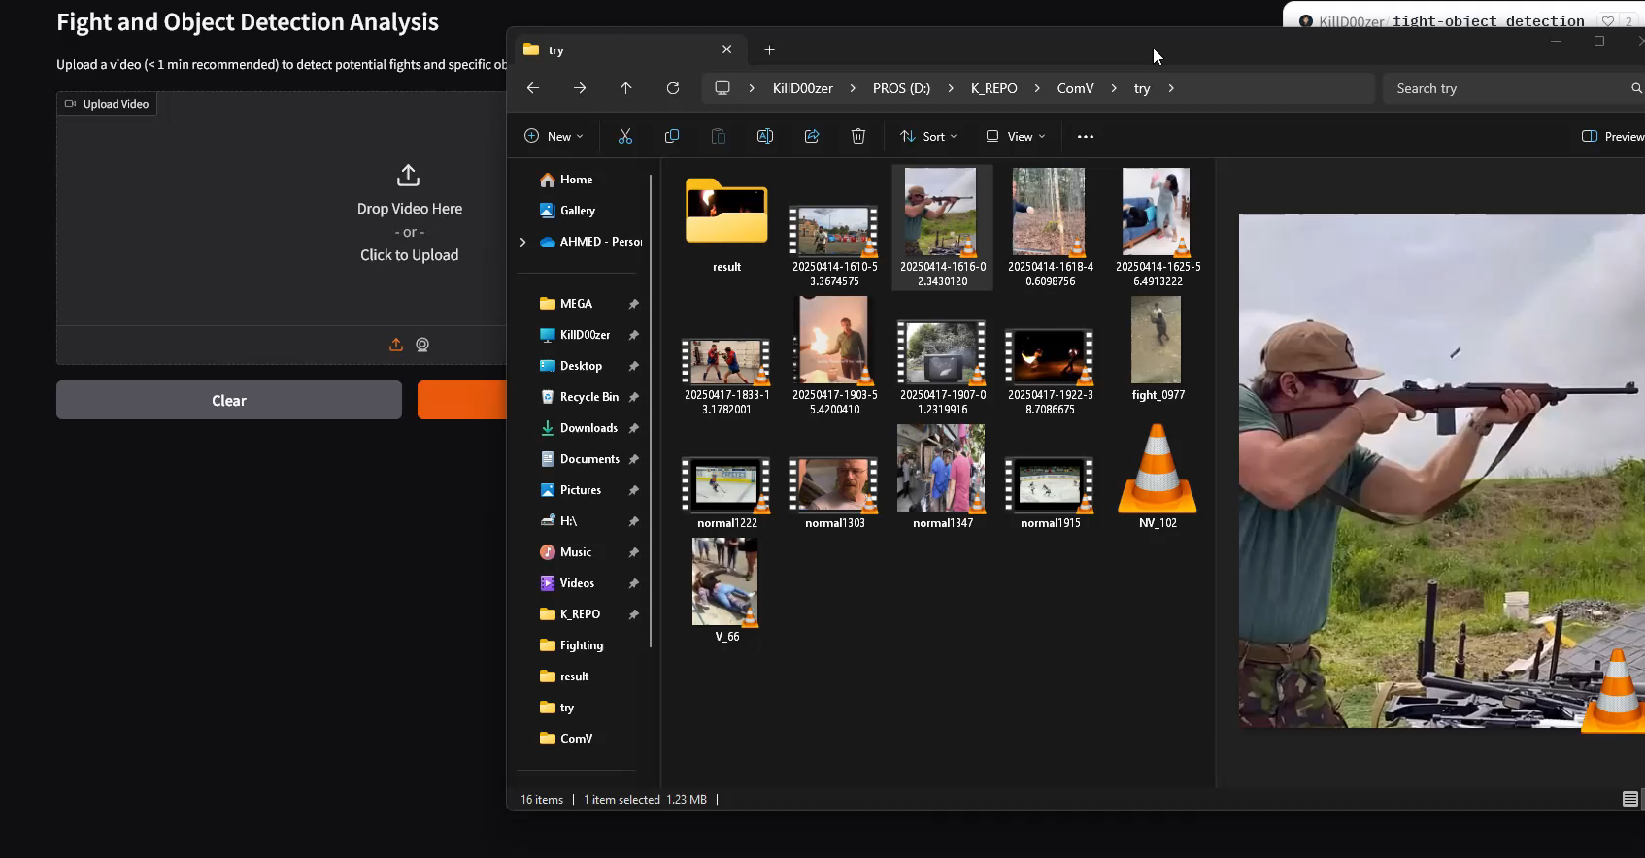
Running Module

Slide 19
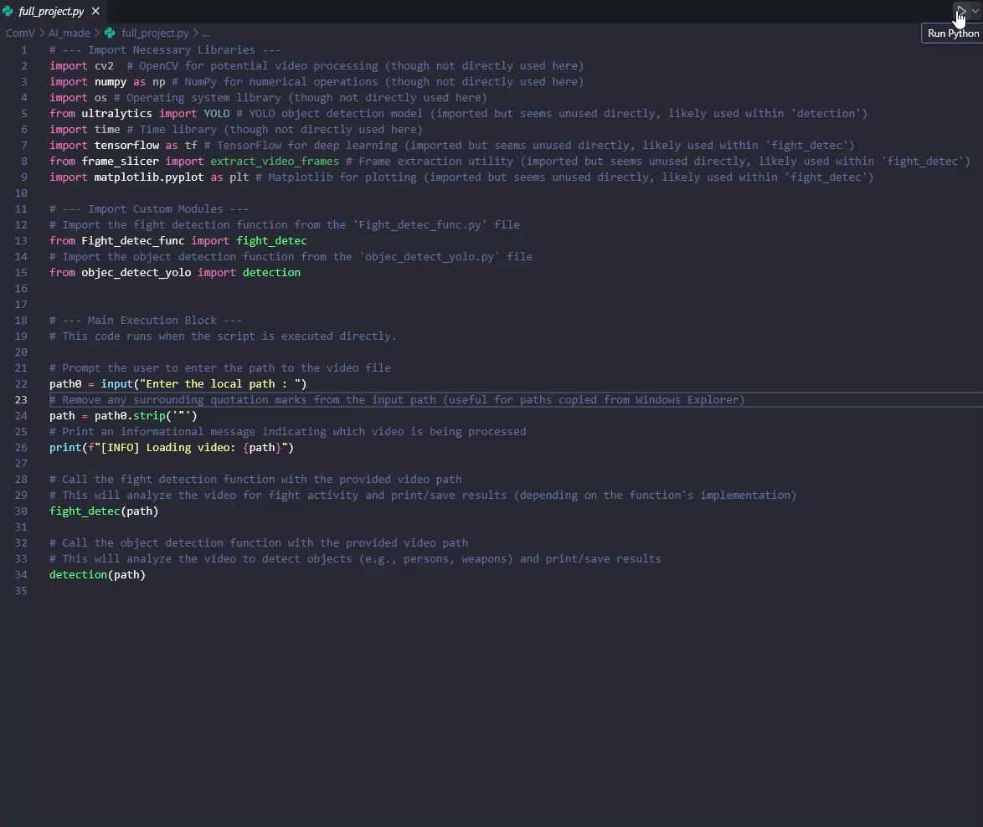
Running Module With Video Annotation

Slide 20








Limitations & Future Work
Real-time Support
Performance Optimization
Add webcam integration for live video processing.
Convert models to TensorRT for faster inference.
Mobile Support
Audio Detection
Develop TensorFlow Lite version for edge devices.
Incorporate sound analysis for gunshots and screams.

Slide 21



Access & Resources
Online Demo
Available on Hugging Face Spaces
Source Code
Complete codebase with documentation
Technical Documentation
Detailed guides and API references
Visit: https://huggingface.co/spaces/KillD00zer/fight-object_detection
Visit: KillD00zer/fight-object_detection: fight & objects detector from videos

Slide 22
Thank You
Questions & Discussion

